Slide 1
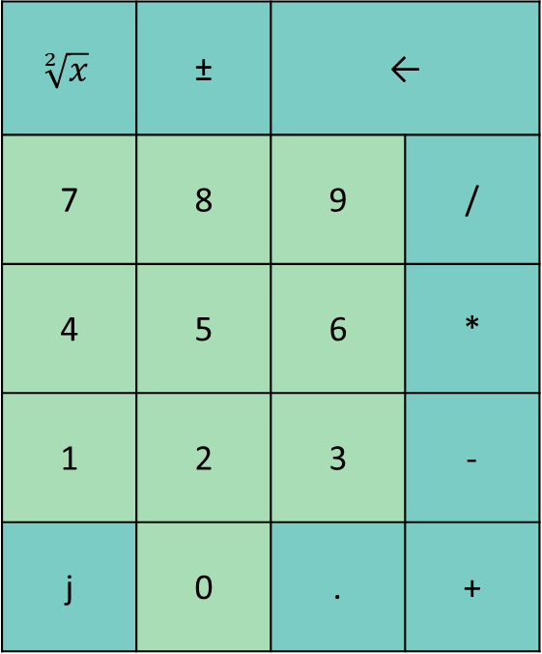
USER INPUT
DROP
DUP
SWAP
OVER
CLEAR
ENTER
STACK
Elenco variabili
$$\sqrt[2]{x}$$ | ± | ←
7 | 8 | 9 | /
4 | 5 | 6 | *
1 | 2 | 3 | -
j | 0 | . | +
>x | <x
+x | -x
x

